Slide 1
The human being at the interface to technology – Practical assistance for realizing cybersecurity through the IT-Security Navigator
Dr. Dennis Kenji Kipker & Sven Müller

Slide 2
The human being at the interface to technology
A case coming from the practice
Assumed you have been working as a water technician in a smaller waterworks for about 20 years. In this function you were and are responsible for the production of high quality drinking water. As a result of the IT-SiG / BSI-KritisV, your employer is now classified as a Critical Infrastructure, so that he has to fulfill additional IT-security duties given by law. As a result, your employer submits a change contract for your existing employment relationship, according to which you now (also) work in the function of the IT security officer in your company. Supposing you sign this contractual document (with no regard to the employment law legality) – what is to do now?

Slide 3
The human being at the interface to technology
National German sources in the field of IT security compliance:
Examples "from A to Z":
AktG, § 91 (Corporation Act)
AtG, §§ 7 ff., 44b (Atomic Act)
BSIG, §§ 3, 4, 7, 7a, 8a ff. (Act of the Federal Office for Information Security)
EnWG, §§ 11 ff., 21e, 49 (Energy Act)
GmbHG, § 43 (Private Limited Company Act)
KWG, § 25a (Banking Act)
TKG, §§ 109, 109a (Telecommunication Act)
TMG, § 13 (Telemedia Act)
VAG, § 64a (Insurance Act)
WpHG, § 33 (Securities Trading Act)
No codified legal regulation of IT security! IT-SiG (2015) → Omnibus law! → Amending law only changes a set of already existing and specialized laws

Slide 4
The human being at the interface to technology
European sources in the field of IT security compliance:
Examples "from old to new":
Directive 2006/32 / EC on energy efficiency and energy services
Directive 2008/114 / EC on the identification and designation of European critical infrastructures and the assessment of the need to improve their protection
Directive 2009/72 / EC on the internal market in electricity
Directive 2013/40 / EU on attacks on information systems
Regulation 2014/53 / EU on the harmonization of the laws of the Member States relating to the provision of radio equipment on the market (RED)
Regulation (EU) No 910/2014 on electronic identification and trust services for electronic transactions in the internal market (eIDAS Regulation)
Regulation (EU) 2016/679 on the protection of natural persons with regard to the processing of personal data and on the free movement of such data, and repealing Directive 95/46 /EC, Art. 5 (1) letter f and Art. 32 (EU GDPR)
EU NIS Directive (2016) + German National Implementation Act (2017)
New EU Cybersecurity Act (announced for 2018)

Slide 5
The human being at the interface to technology
Example of IT-security regulation #1: BSIG
§ 8a BSIG - Security in Information Technology of Critical Infrastructures
(1) Operators of Critical Infrastructures shall take appropriate organizational and technical measures to avoid disruptions to the availability, integrity, authenticity and confidentiality of their information technology systems, components or processes which are relevant for the functioning of the Critical Infrastructure they operate. The technical state-of-the-art should be adhered to. Organizational and technical arrangements are appropriate, if the effort required is not disproportionate to the consequences of failure or impairment of the Critical Infrastructure concerned.

Slide 6
The human being at the interface to technology
Example of IT-security regulation #2: GmbHG
§ 43 GmbHG - Liability of the managing directors
(1) The directors have to exercise the diligence of a proper businessman in the affairs of the company.
(2) Managers who violate their obligations shall be jointly liable to the company for the damage incurred.

Slide 7
The human being at the interface to technology
Indefinite legal concepts and their concretization
Example:
Concretization of the technical state-of-the-art according to § 8a BSIG by the ISMS: Information Security Management System (ISMS) according to ISO / IEC 27001 presupposes that new threats are continually recorded and effective and up-to-date countermeasures are implemented
This also includes technically new situations, some of which have reached the circle of users (state of the art as defined by the Manual of Legal Formality of the BMJV)
Through current adaptation (PDCA + BCM) of technical systems, care is taken to ensure that their status does not fall back to the level of the "generally recognized rule of technology", but topicality does not need to meet the highest requirements of "science and technology" either
Thus important: Assignment of a TOM to a stage can change over time, so that it may no longer meet the standards required by the law!

Slide 8
The human being at the interface to technology
Certification following ISO/IEC 27001
Term standard
27000
No specific requirements for (SME)
Requirement standard
27001
27006
27009
ISMS-Standard-Family
Guideline Standard
27002
27003
27004
27005
27007
27013
27014
27016
Sector-specific
27010
27011
27015
27017
27018
27019
Activity-based Guideline Standards
27037
27040
27043
27038
27041
27044

Slide 9
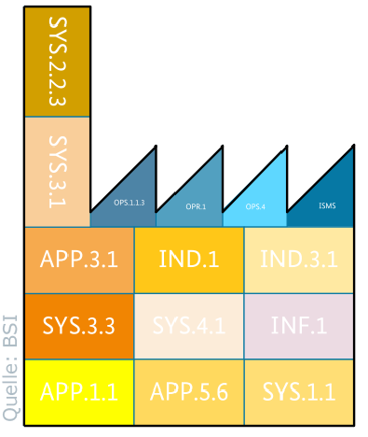
The human being at the interface to technology
IT-Grundschutz for KMU (= Small and Medium Enterprises)
The application of IT-Grundschutz-profiles requires the following:
Low Security Expertise
Basic: IT-Grundschutz
Risk analysis only in exceptional cases
Sector specific assistance for the creation of risk analyses
Little Time
Basic idea of the profiles, relieve users from their duty to design models
High precision fit of the models by choosing a homogenous scope
Little given documentation
Profile creates documentation
Intuitive adaptation to the user by use cases
Pilot Profile
https://www.bsi.bund.de/SharedDocs/Downloads/DE/BSI/Grundschutz/Hilfsmittel/Extern/Diplomarbeiten/Fluchs_Profil_Wasser.html

Slide 10
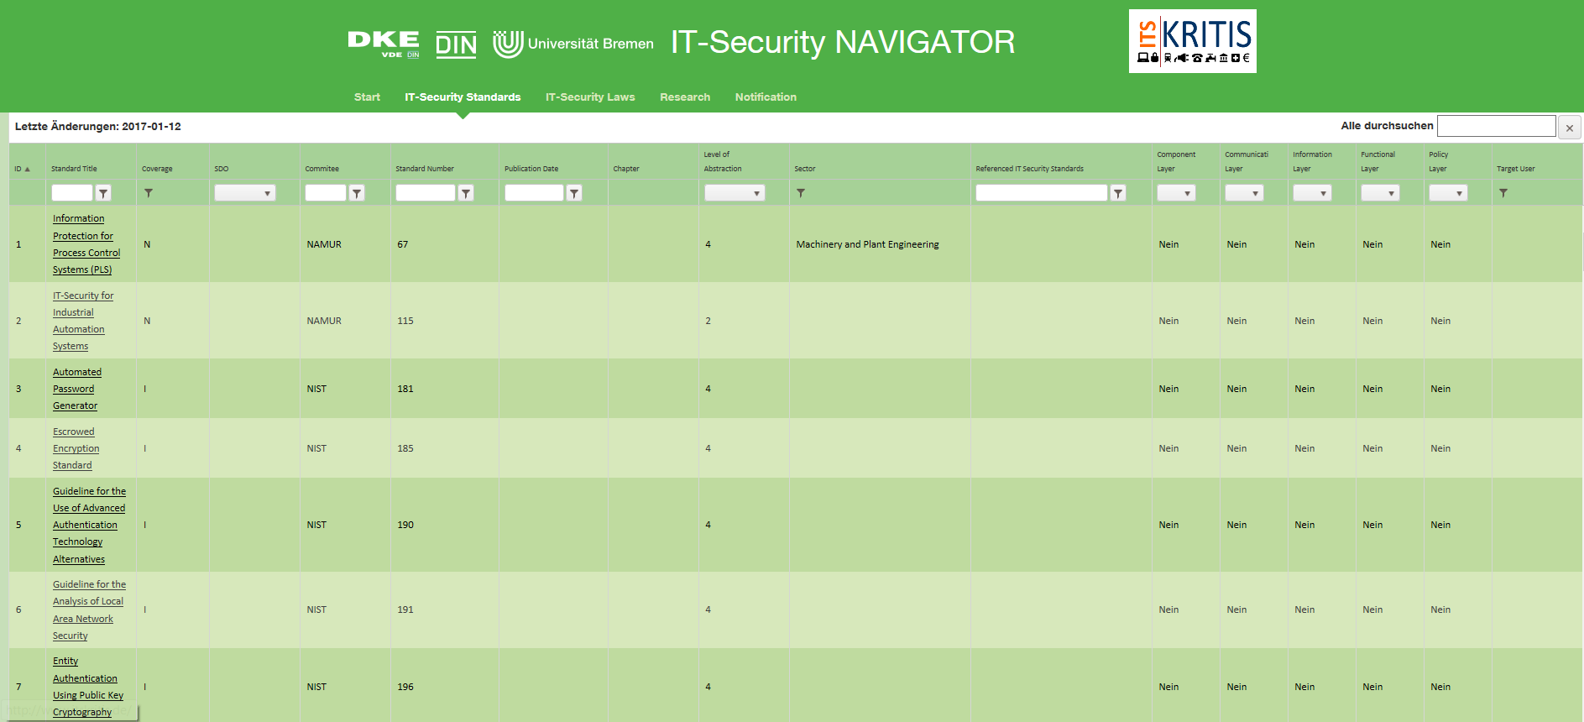
The human being at the interface to technology
www.itsecuritynavigator.de/

